Slide 1
Existing practices and established Master’s Curricula in England
Dr Sally Priest, Flood Hazard Research Centre
6th April 2017

Slide 2
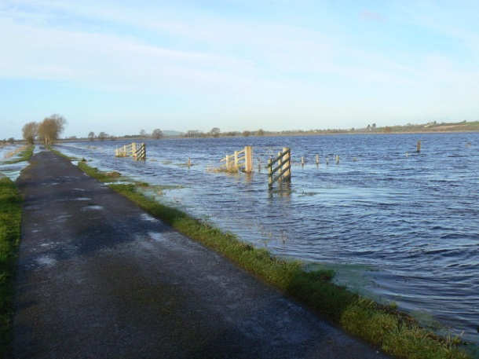
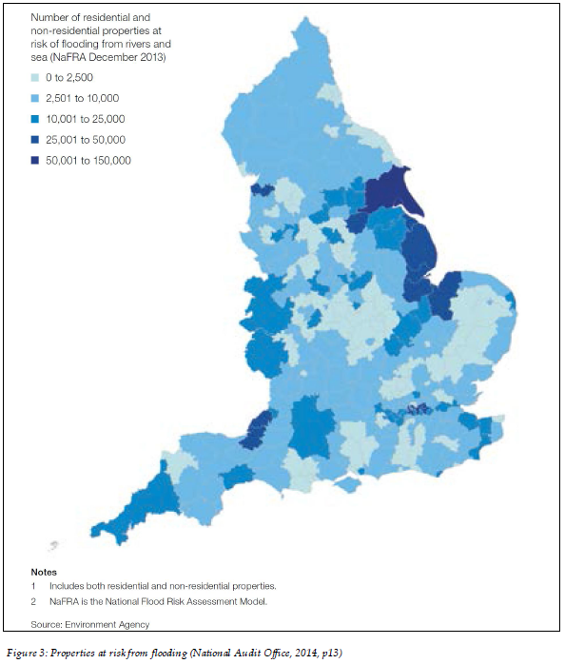
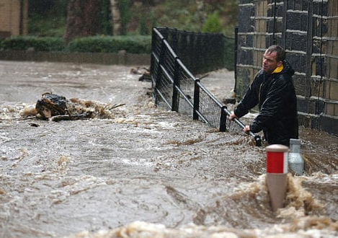
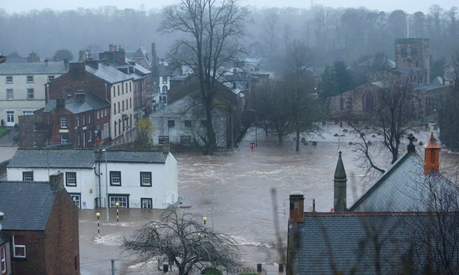
Past events and current risks
The UK is exposed to multiple types of flooding
1 in 6 residential and commercial properties are at risk (5.2 million)

Slide 3
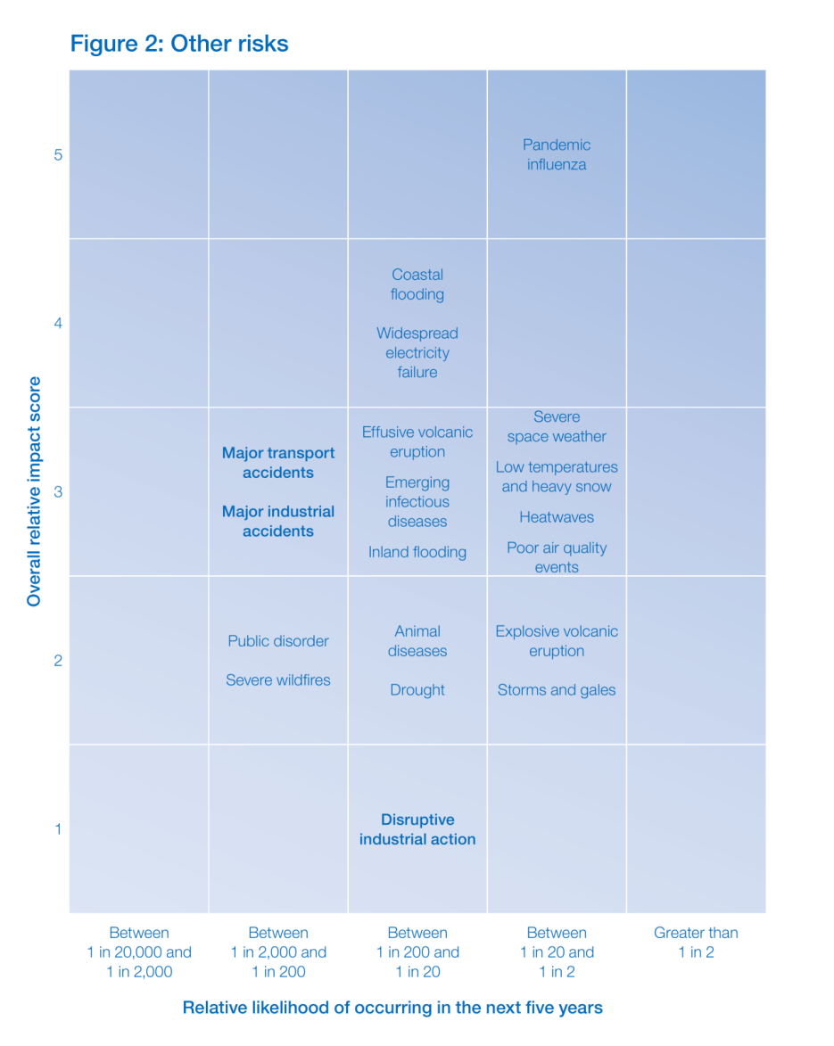
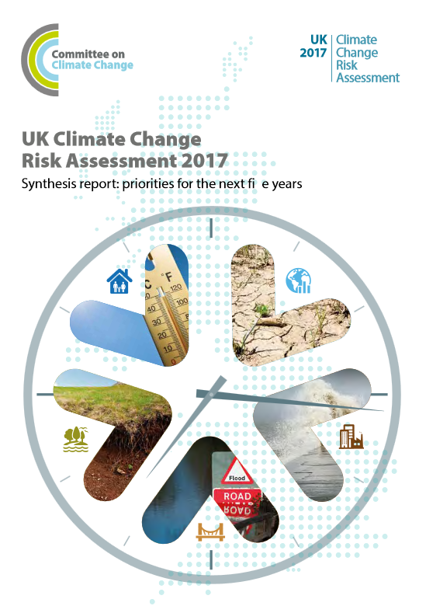
Identifying and prioritising risks
Notes:
The UK is exposed to many types of flooding, including coastal, fluvial, surface water and groundwater. Within our National Adaptation Programme and Climate Change Risk Assessment flooding is identified as a significant risk for the future. In fact, Expected Annual Damage to properties due to flooding (currently at £1.2 billion) is estimated to rise to £6.8bn by 2050. And flooding is a fairly frequent occurrence, particularly over the past few winters and already this year we’ve seen some significant storms that have led to wide-spread flooding in the country.

Slide 4
Managing risks: multiple approaches and integration
Minimise exposure (e.g. spatial planning)
Reduce the likelihood and/or magnitude of flooding by resisting water (e.g. dykes, embankments) or accommodating and making space for water (e.g. flood storage areas)
Preparation & response
(e.g. flood warning, emergency management)
Recovery
(e.g. insurance, compensation)
English crisis management
Notes:
We principally adopt a multiple approach to managing disasters – example for flood risk management where we would argue that we do not really have a dominant strategy – but all have been present and utilised for over 65 years. But that is not to say that some are more dominant in local situations than others.

Slide 5
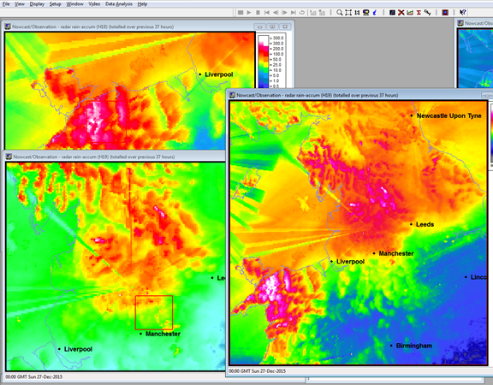
Forecasting, Alerts and warnings
Warning sirens; radio; TV; flood wardens; emergency responders; the community; social media – e.g. @EnvAgency
Opt-out service – landline telephone numbers automatically signed-up to receive warnings to c.660,000 homes and businesses
Exploring technology to issue warnings to all mobile phones within a specified radius
'Flood Alert' app for mobile phones uses live flood warning data from the EA (launched by Halcrow)

Slide 6
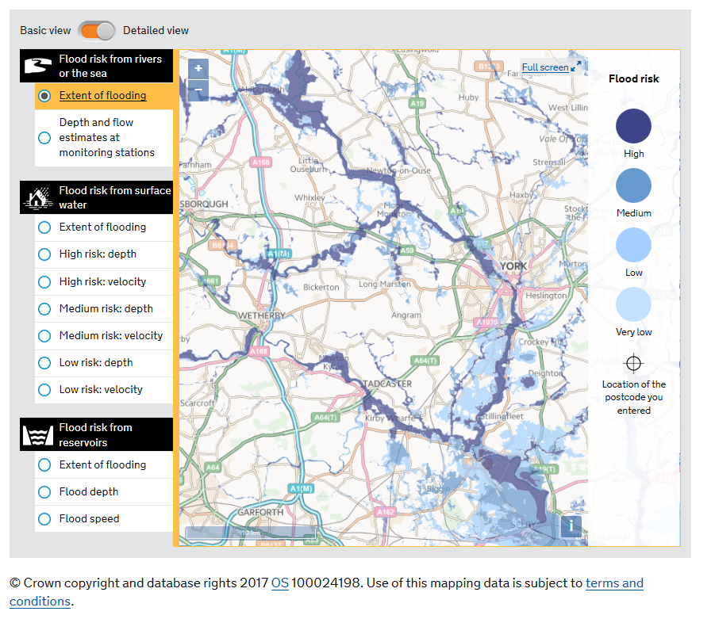
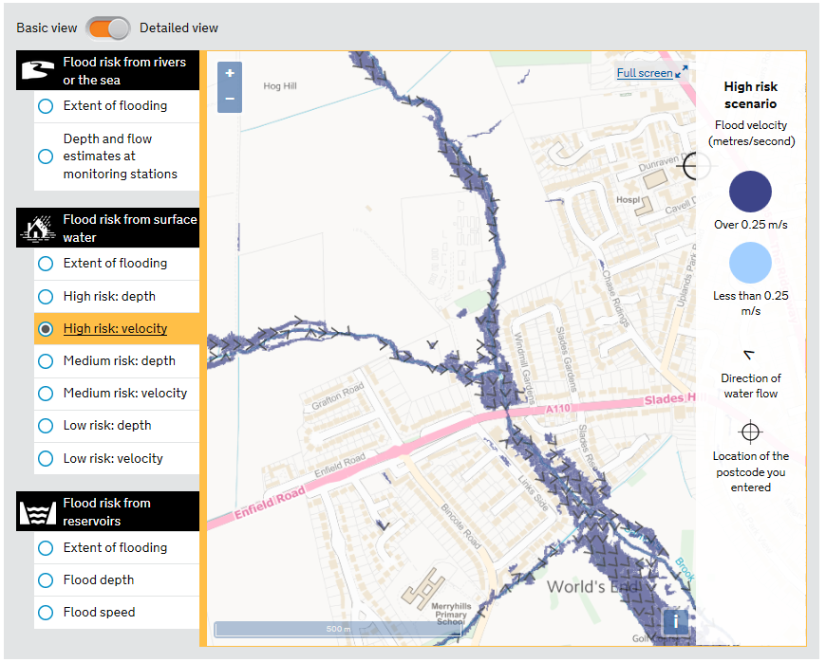
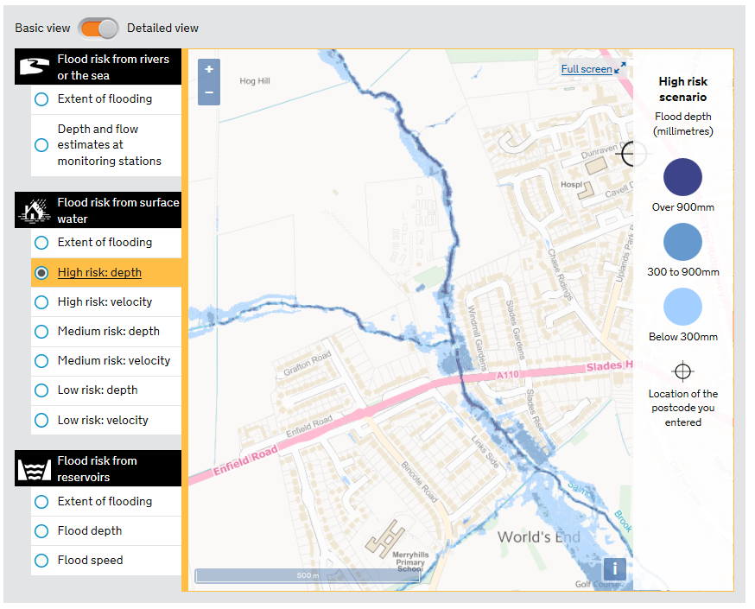
Notes:
Multiple types of flood map available
Mapping been publically available for many years.

Slide 7
Forecasting, Alerts and Warnings
Type of warning | Description | Provider
Public flood warning service | Warning for areas at risk of flooding from rivers or the sea, under the categories of Flood Alert, Flood Warning and Severe Flood Warning. Public and professional recipients | Environment Agency
Flood Guidance Statements | Guidance for river and coastal flooding available from the FFC. 3 to 5 day forecasts issued daily for very low and low risk; medium risk; and high risk. Issued to Category 1 and 2 responders only | Flood Forecasting Centre
Extreme Rainfall Alerts | Issued by FFC when probability of extreme rainfall is >20%. Alerts issued daily in the form of guidance and update statements. These warnings may indicate potential for surface water flooding | Flood Forecasting Centre
Severe Weather Warning (National Severe Weather Warning Service, NSWWS) | Met Office will issue warnings for severe weather events with the potential to cause disruption (based on the National Severe Weather Warning Service). Publically available | Met. Office
Advisories | Issued daily to indicate 20% - 60% confidence of expected severe or extreme weather. Early warnings: issued up to 5days in advance of an event and indicate 60% - 80% confidence of expected severe or extreme weather. Flash warnings: issued when confidence exceeds 80% and gives a minimum of 2hrs notice. | Met. Office
Groundwater flood warnings | Data on the status of groundwater in areas of England are provided on-line and for some areas groundwater flood warning alerts are available | Environment Agency
Types of warnings issued by the EA, FFC and Met Office in England
The EA is the lead agency responsible for disseminating flood warnings in England and Wales
The EA also has a live flood warning map
Opt-out service – landline telephone numbers automatically signed-up to receive warnings
Notes:
http://apps.environment-agency.gov.uk/flood/142151.aspx

Slide 8
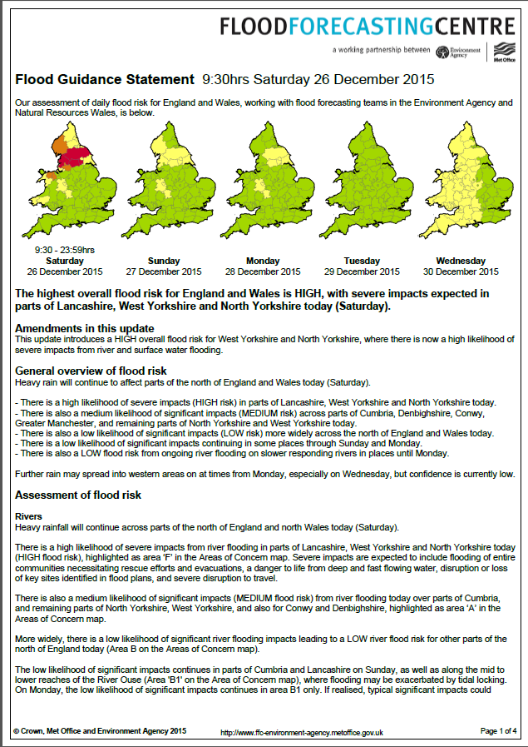
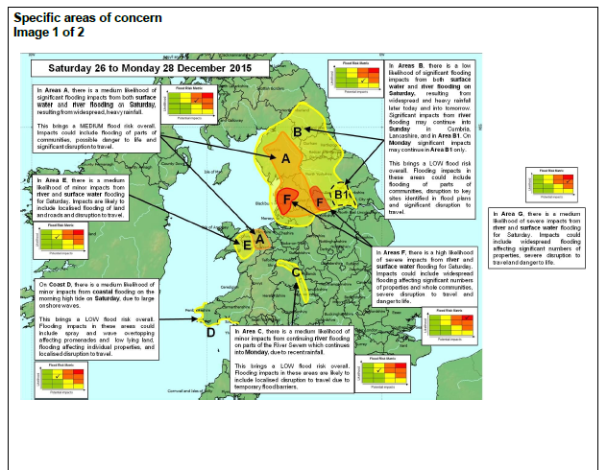

Slide 9
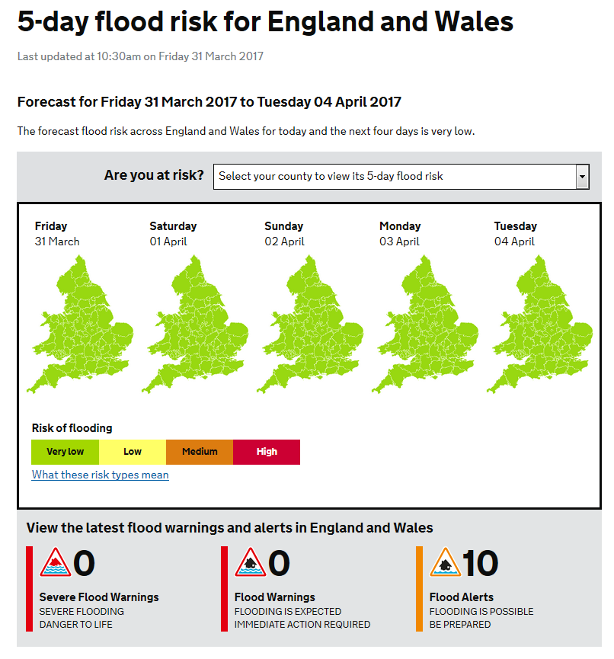
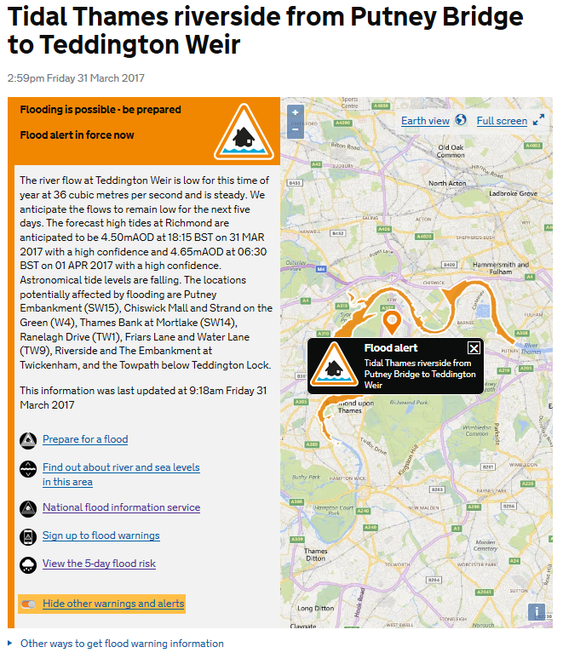
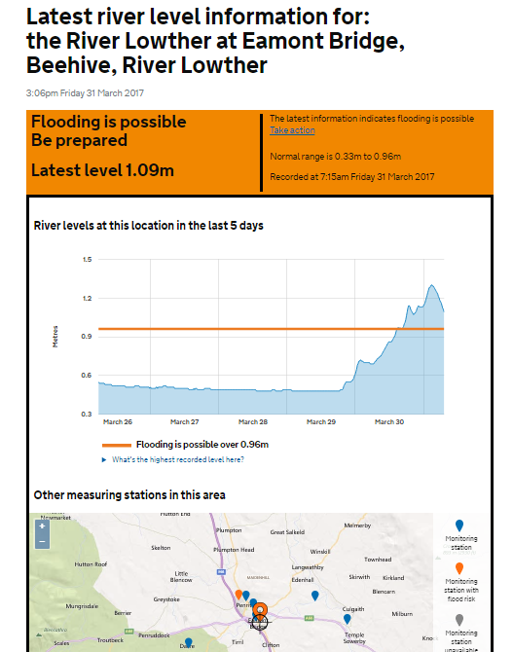
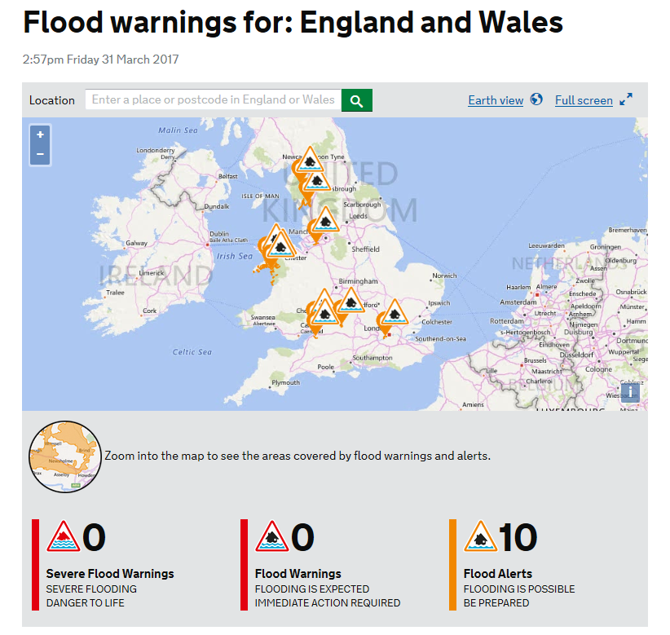
https://flood-warning-information.service.gov.uk/map

Slide 10
Heatwave alert warnings and Heatwave Action plan
Established 2015 – 1st June – 15th Sept
Regionally different trigger levels
Defines responsibilities and action by different groups
Notes:
Level 0: Long-term planning to reduce risk from heatwaves - Long-term planning includes year-round joint working to reduce the impact of climate change and ensure maximum adaptation to reduce harm from heatwaves.
Level 1: Heatwave and summer preparedness - Summer preparedness runs from 1 June to 15 September when a Level 1 alert will be issued.
Level 2: Alert and readiness - This is triggered as soon as the Met Office forecasts that there is a 60 per cent chance of
temperatures being high enough on at least two consecutive days to have significant effects on health. This will normally occur 2 to 3 days before the event is expected. As death rates rise soon after temperature increases, with many deaths occurring in the first two days, this is
an important stage to ensure readiness and swift action to reduce harm from a potential heatwave.
Level 3: Heatwave action - This is triggered as soon as the Met Office confirms that threshold temperatures have been reached in any one region or more. This stage requires specific actions targeted at high-risk groups.
Level 4: National emergency - This is reached when a heatwave is so severe and/or prolonged that its effects extend outside health and social care, such as power or water shortages, and/or where the integrity of health and social care systems is threatened. At this level, illness and death may occur among the fit and healthy, and not just in high-risk groups and will require a multi-sector response at national and regional levels.
Levels 2 to 3 are based on threshold day and night-time temperatures as defined by the Met Office. These vary from region to region, but the average threshold temperature is 30ºC during the day and 15ºC overnight.

Slide 11
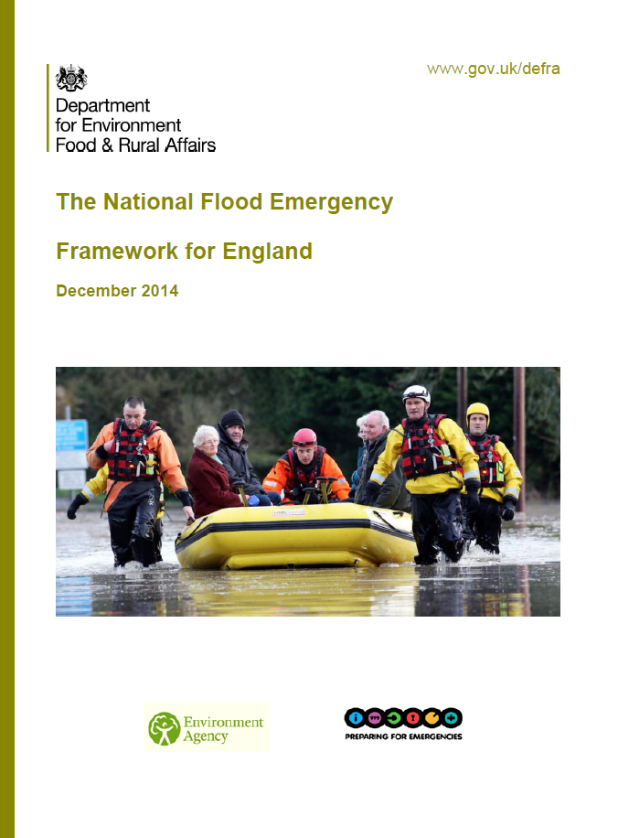
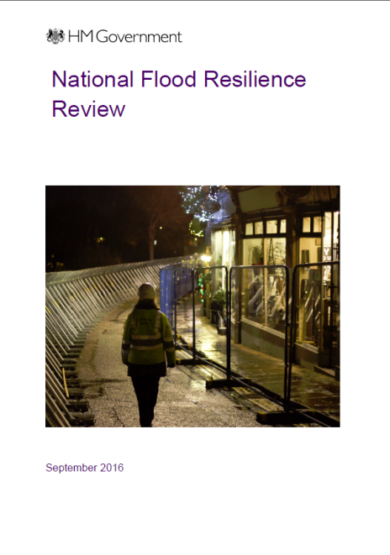
Emergency management in England
Planning
Response
Recovery
Planning – risk assessment (community risk registers), emergency plans for general and specific events, business continuity, activation and trigger levels etc.
Characterised by integrated working and multi-agency planning and working
Coordinated by Local Resilience Forum
Involvement of communities
Notes:
Planning – identifying and targeting the vulnerable. – Community risk registers
E.g. elderly, young, limiting long-term illness, disabled etc.
Physical and social dependencies
Critical vulnerabilities – those who are dependent on electricity (oxygen supply, home dialysis patients)
Key contacts established during planning
Vulnerability of responders
Also learning from past lessons.

Slide 12
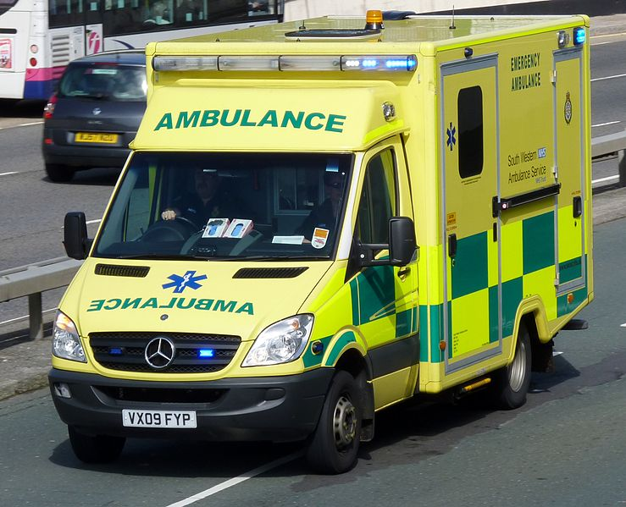
Emergency response: Civil Contingencies Act 2004
Category 1 responders – Local Authority, Environment Agency, “blue light responders” & health authorities (NHS, PCT, PHE)
Category 2 responders – Utility companies (gas, electricity, water, telecoms), transport operators (rail, airport, harbour, highways), Health and Safety Executive & Strategic Health Authority
Integrated Emergency Management – joined-up working, information sharing, coordinated response
Notes:
Conceptualised in two areas
Crisis management – prevent or avert emergency, or put in place measures to mitigate its effects (e.g. evacuation)
Consequence management – prevent impact of event escalating. Includes managing wider consequences and services(e.g. restoring electricity, transport), housing displaced persons

Slide 13
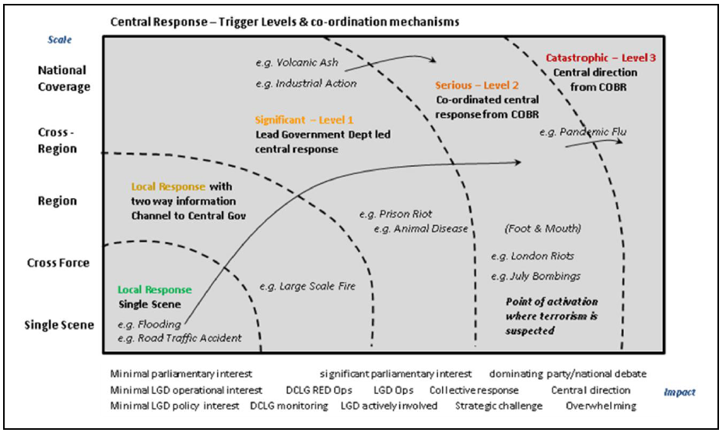
Levels of emergency
Emergencies are categorised into 3 levels
For Level 2 (significant) and Level 3 (catastrophic) events the Cabinet Office Briefing Room (COBR) is established
In the extreme case, Defra as the Lead Government Department will merely support the Civil Contingencies Secretariat, who will coordinate the central response within COBR.
See The National Flood Emergency Framework for England (Defra, 2013)

Slide 14
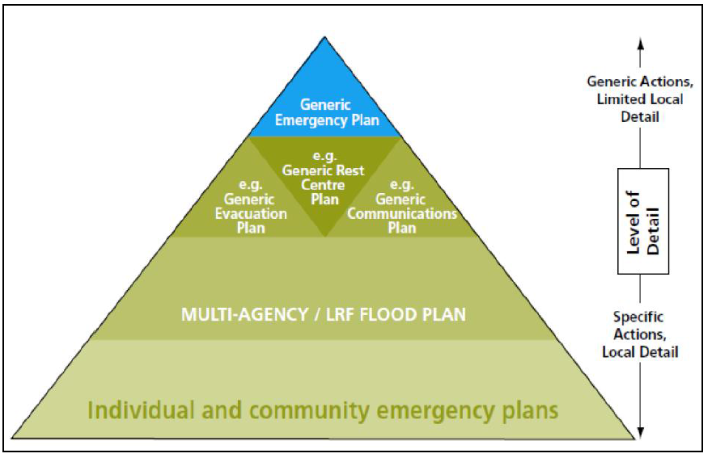
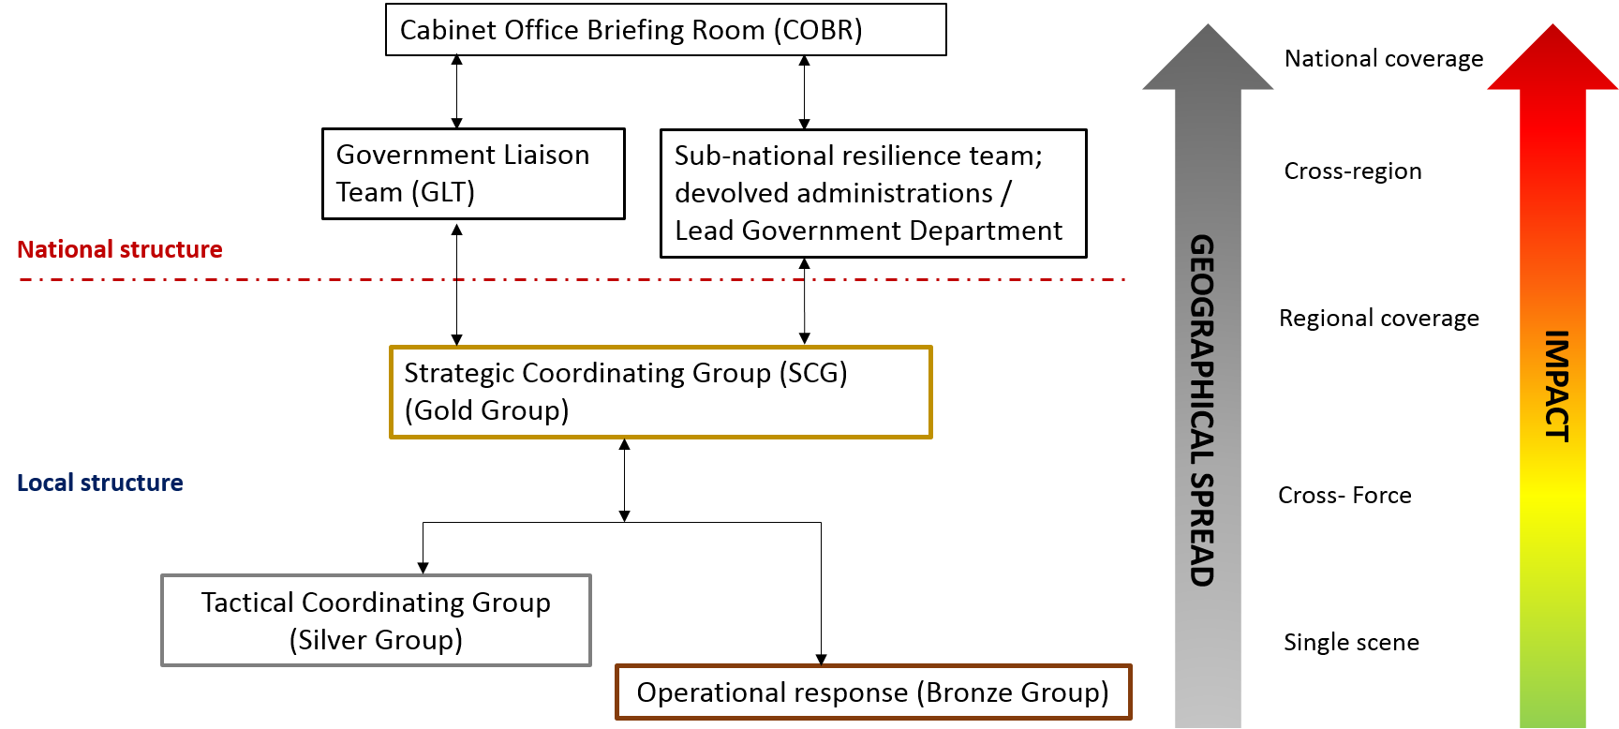
Subsidiarity and the command structure

Slide 15
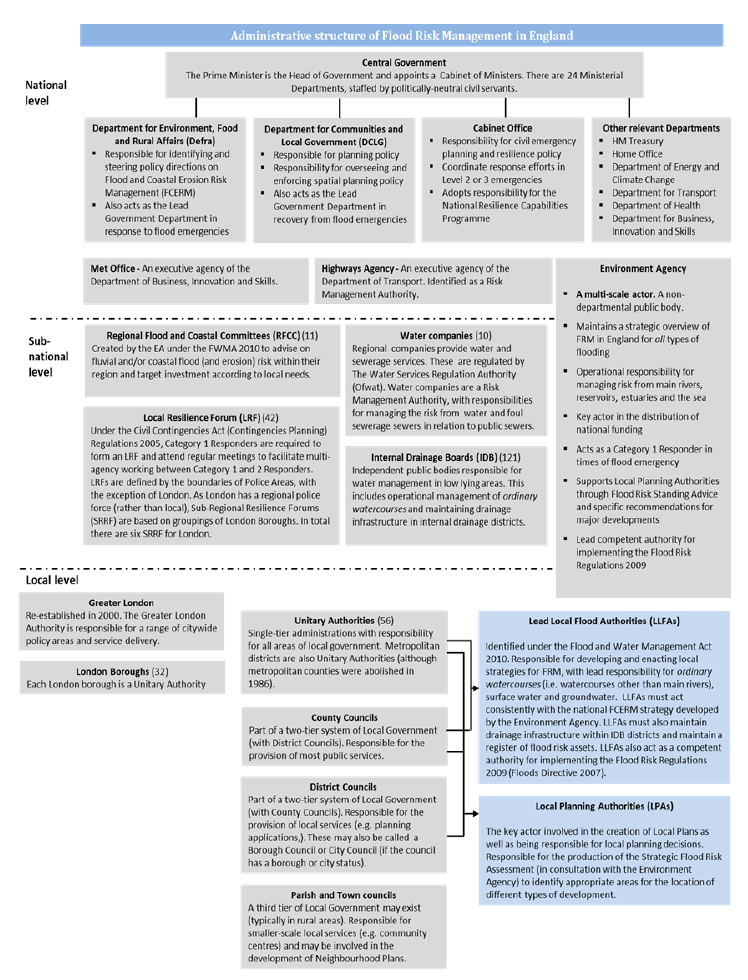
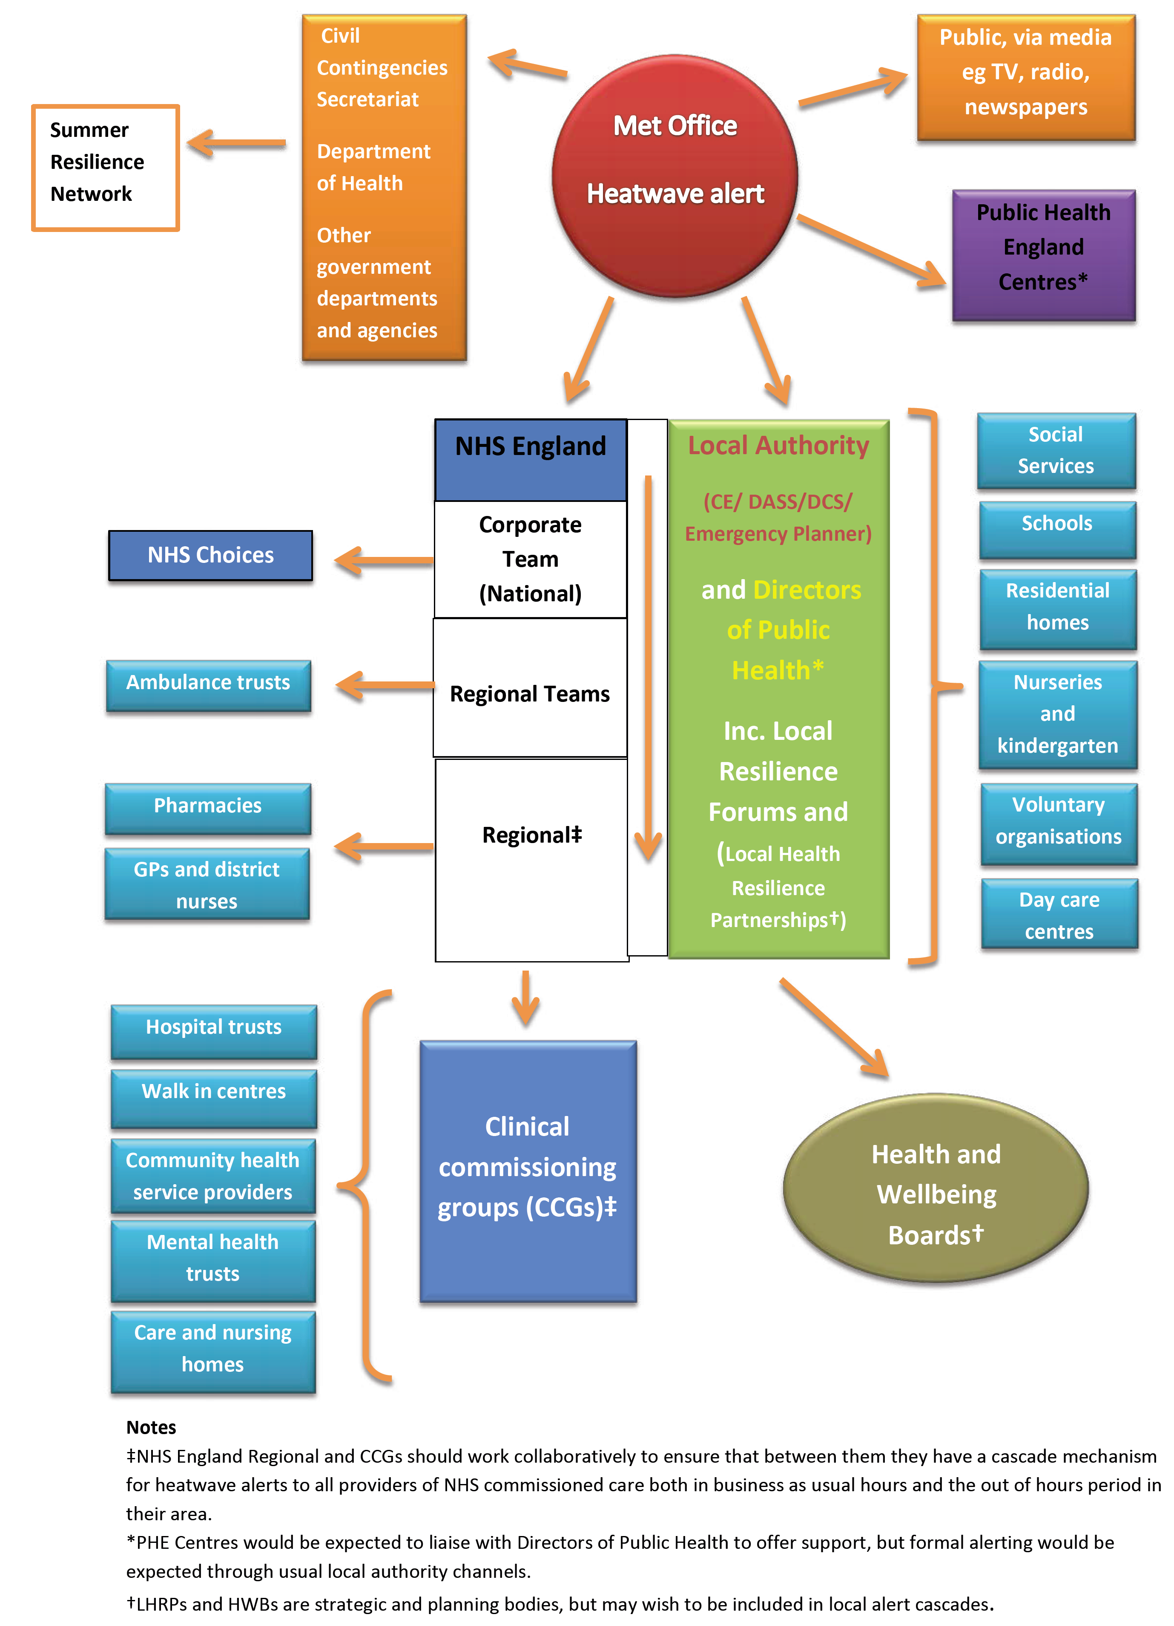

Slide 16
Community engagement, resilience and flood action
National Flood Forum – a nationally-registered charity to support local communities
Ca. 160 Community flood action groups
Flood Resilience Community Pathfinder Scheme- £5m to 13 communities e.g. river monitoring, interactive flood ‘toolkit’ websites, the development of community Flood Action Plans to support emergency response and enlisting voluntary flood wardens to disseminate official flood warnings
Goal is to raise risk awareness, increase ownership of responsibility and encourage resilient behaviour

Slide 17
Key strengths
Room for improvement
Long-standing and diverse approach to managing emergencies and disasters
Balance between local and national management
Well-established forecasting and warning capabilities
Community involvement – long standing inclusion and engagement
Public and private engagement in recovery
Funding – continued availability and prioritisation
Some types of risk management less established (e.g. SWF)
Not all communities are prepared – room to increase resilience and raise awareness
Enforcement of planning conditions and encroachment into risky areas

Slide 18
Existing UK Masters Curricula

Slide 19
Existing UK Masters Curricula
Many other MA/MSc courses will have elements related to DRR, crisis management (geography, engineering)
Focussed on those specialising in crisis/disaster management
15 courses (predominantly MSc) offered in 11 universities
Many vocations: insurance; catastrophe modelling; risk management; public policy; humanitarian development; NGOs; business continuity; government; emergency services; consultancy and academic research

Slide 20
MA/MSc Disasters, adaptation and development, Kings College London | MSc Emergency Planning and Management, Coventry University
MSc Risk and Disaster Science, Institute for Risk and Disaster Reduction, University College London (UCL) | MSc Risk Disaster and Environmental Management, University of Huddersfield
MSc Risk and Disaster Resilience, Institute for Risk and Disaster Reduction, University College London (UCL) | MSc International Disaster Management, University of Manchester
MRes Risk and Disaster Reduction, Institute for Risk and Disaster Reduction, University College London (UCL) | MRes Disaster Resilience and Management, University of Salford
MSc Disaster Management and Sustainable Development, Northumbria University | MSc Disaster Management for Environmental Hazards, University of South Wales
MA/MSc in Risk, Durham University | MSc Crisis and Disaster Management, University of Lincoln
MSc Crisis and disaster management, University of Portsmouth | MSc Risk, Crisis and Disaster Management, University of Leicester
MSc Disaster Management, Coventry University

Slide 21
Types of course
Common features
Development focused
DRR and more academic focus - theoretical
More occupationally driven – management and response practices
One course delivered predominantly online and via distance-learning
Only one MRes course
Most were modular with a mix of compulsory/optional modules
All had an independent study component
Sometimes more innovative – e.g. work placement-based, overseas visit
Few appeared overtly to have lab elements

